Slide 1
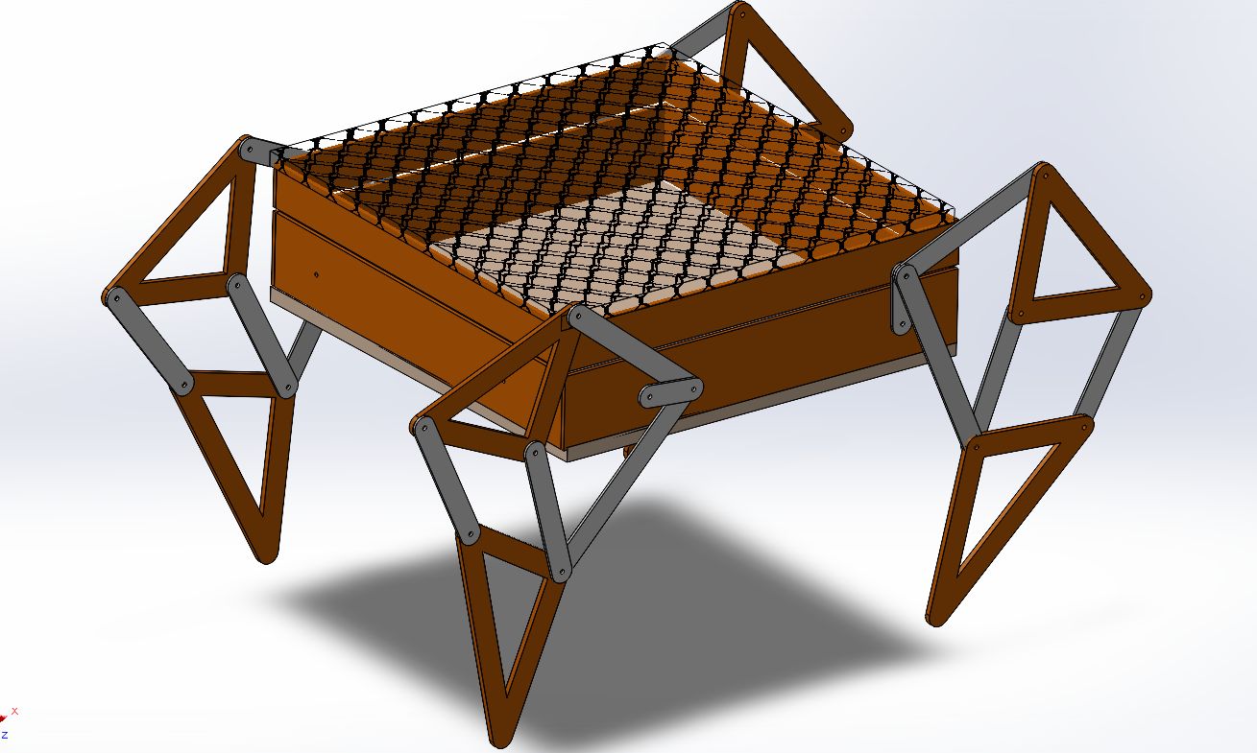
Design of Quadruped robot using Theo-Jansen Mechanism
Mini Project by :
Omkar Malusare(32)
Sahil S Patil(45)

Slide 2
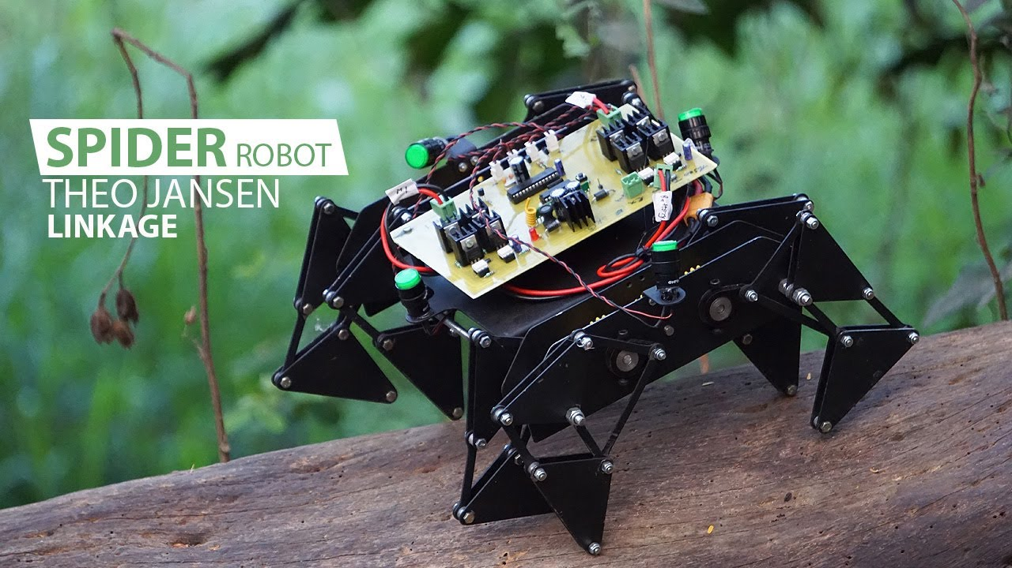
INTRODUCTION:
Spider or Quadruped Robot is a four-legged walking robot which is a bionic replica of spider (Arachnid species) that uses their legs for movement and can perform tasks either by human interaction .
Legged robots are a type of mobile robot which use mechanical arm for movement. These robots are more versatile than wheeled robots. It is known that animals can travel over rough surface at speeds much greater than wheeled or tracked vehicles. Wheeled vehicles are not suitable for rough surface due to some reasons.
It is also practically impossible for most automobiles to move over vertical surfaces. Even on very sandy and circular edge surfaces most automobiles slip frequently. The facts are that, there is still a lot of scope left for changing the way.

Slide 3
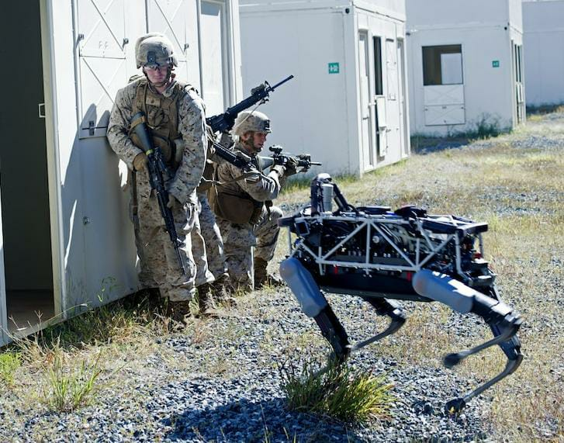
Project Objective:
The objective is to build up a mechanical robotic walker using an eight-bar link mechanism. The system uses a robot that is capable of walking towards the object according to the remote controlled input.
The aim is to build a robot which is Cost effective and Consume’s less electricity.
The main objective is to build a surveillance robot for the military professional and for the patrolling staff.
A detailed analysis of the mechanism is been done using the software's. With the improvement and implementation of new technology, the cost of expenditure maybe be increased and smoother movement of the robot will be provided.

Slide 4
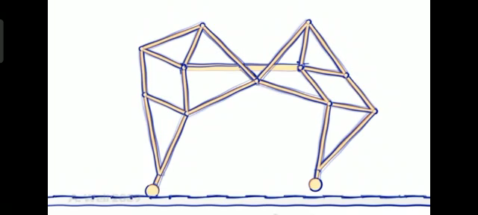
Mechanism:
The robot works on the Jansen meachanism which is designed by a Dutch artist Theo Jansen . This mechanism is use to drive four legged mini robot .
The kinematics of this robot will allow it to move on different terrain at different speeds. IT has four legs. The linkage consists of the frame, crank, two pivoted rockers, and two couplers all connected by pivot joints. The kinematics of robots structure enables it to convert the rotating motion of the crank into the movement of foot similar to that of creature strolling.
The most important benefit of this mechanism is that, it does not require microprocessor, controller and other actuator mechanisms. By copying to the physical structure of legged animals, it may be possible to improve the performance of the mobile robots. This mechanism is use to drive four legged mini robot and actualize this mechanism using the robotic medium.

Slide 5
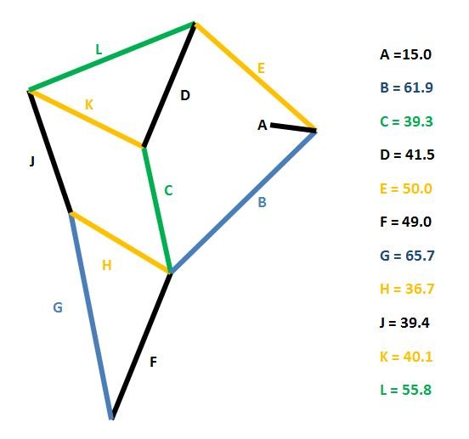
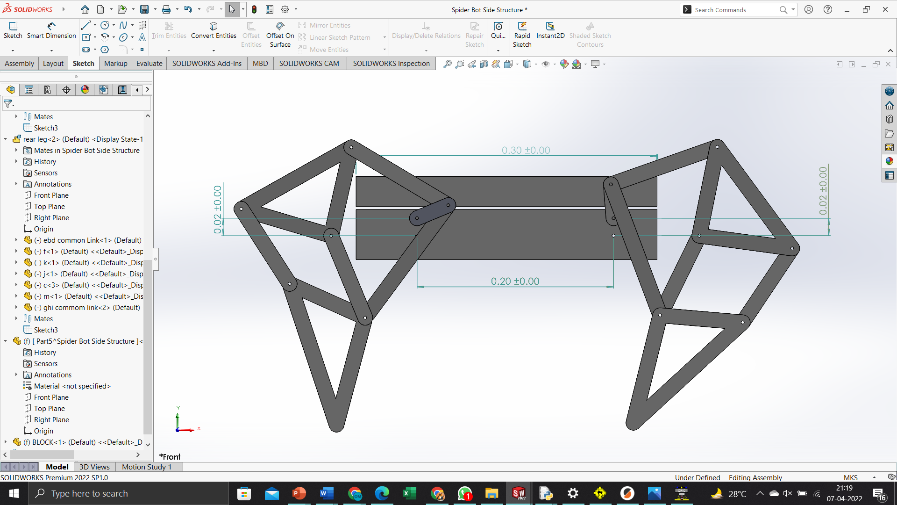
Structural Diagram:

Slide 6
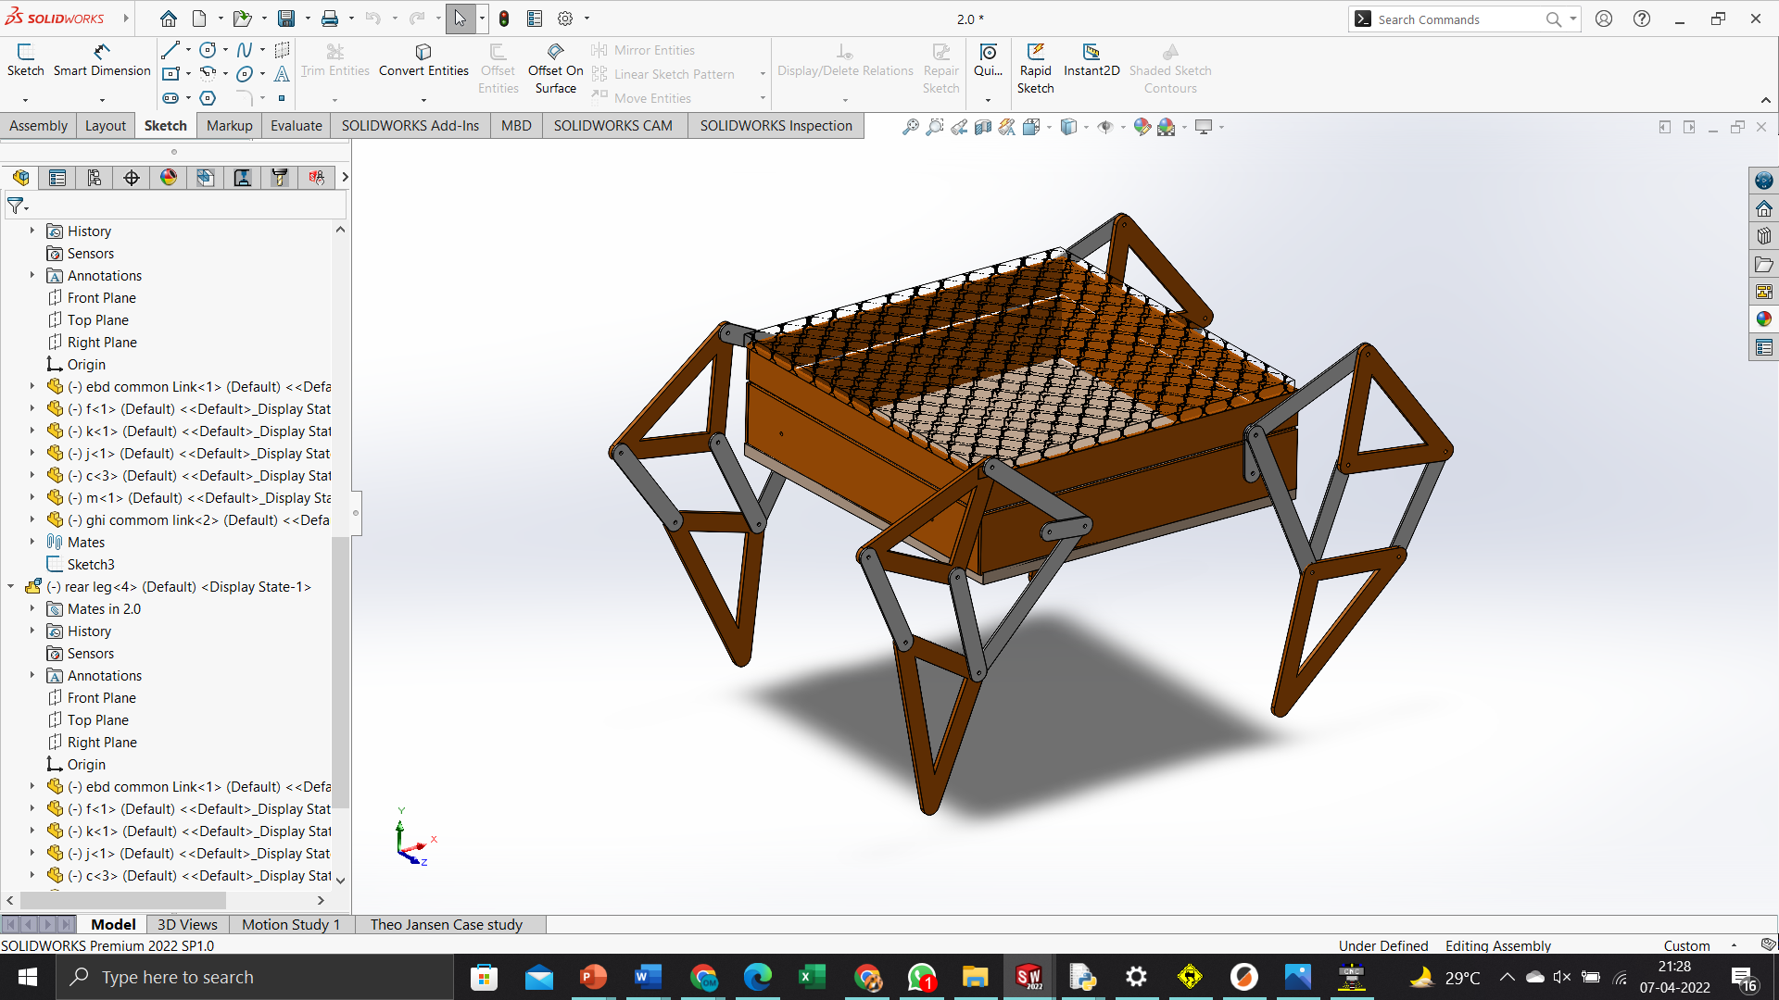
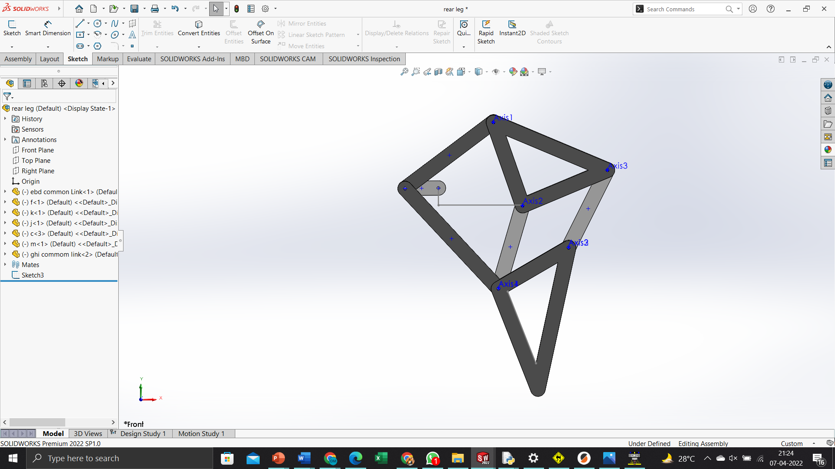
Detail Design:
Spider Robot Cad Design
Leg Design

Slide 7
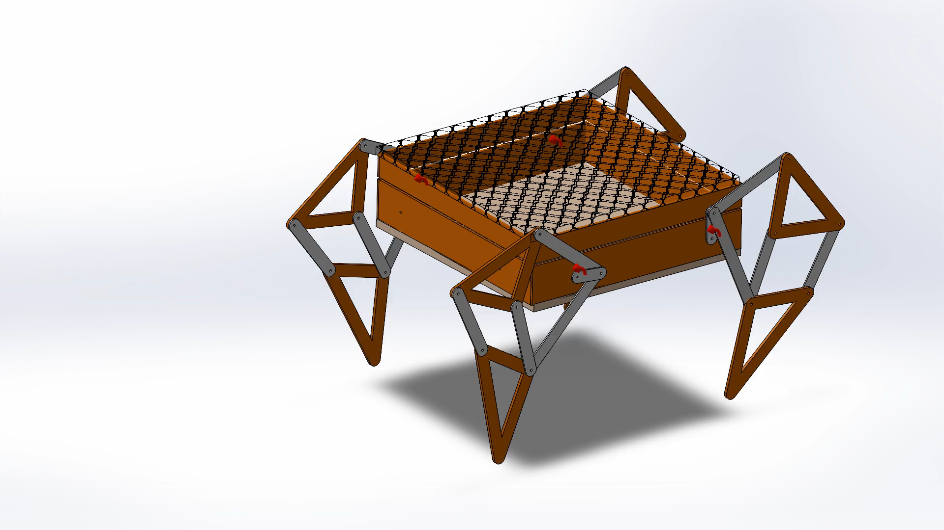
Solidworks Motion Study of the Spider Bot :-

Slide 8
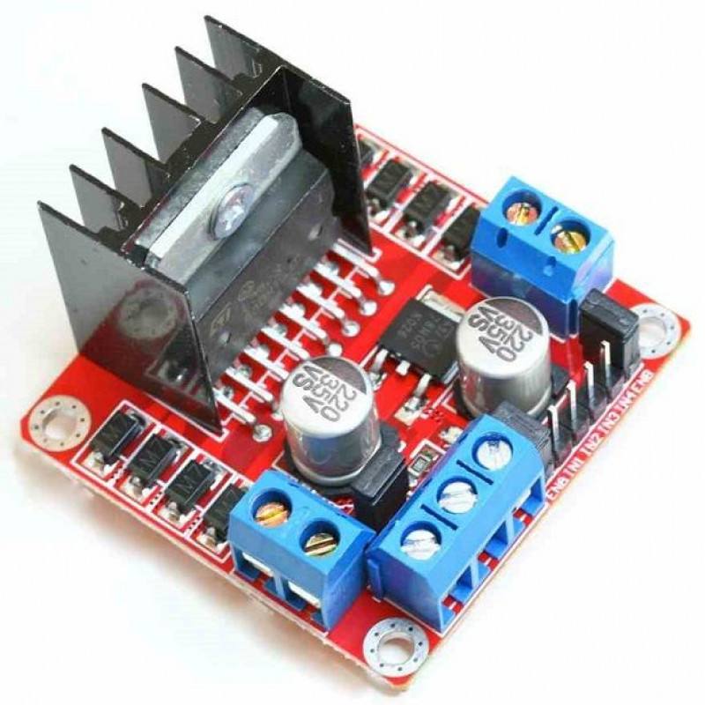
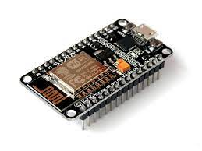
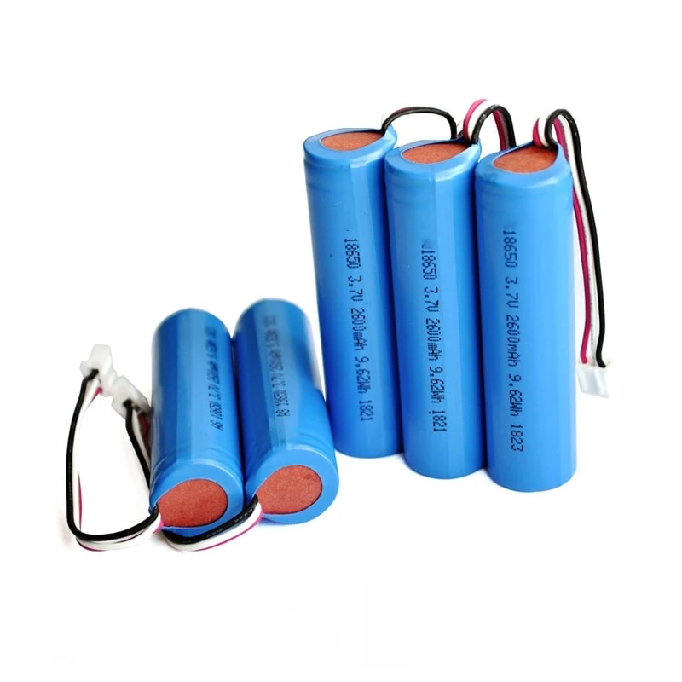
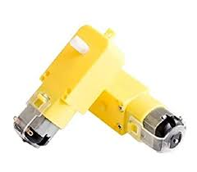




Components

Slide 9
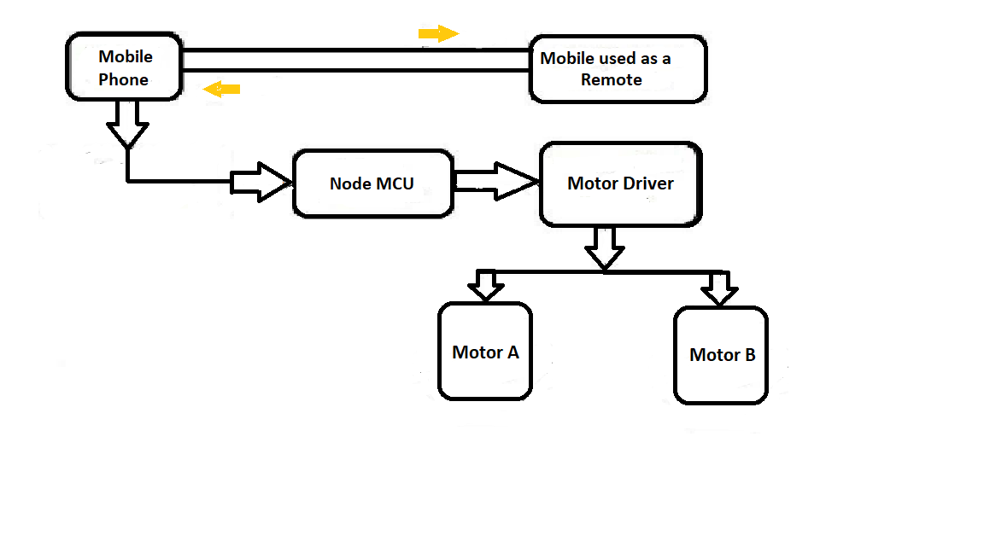
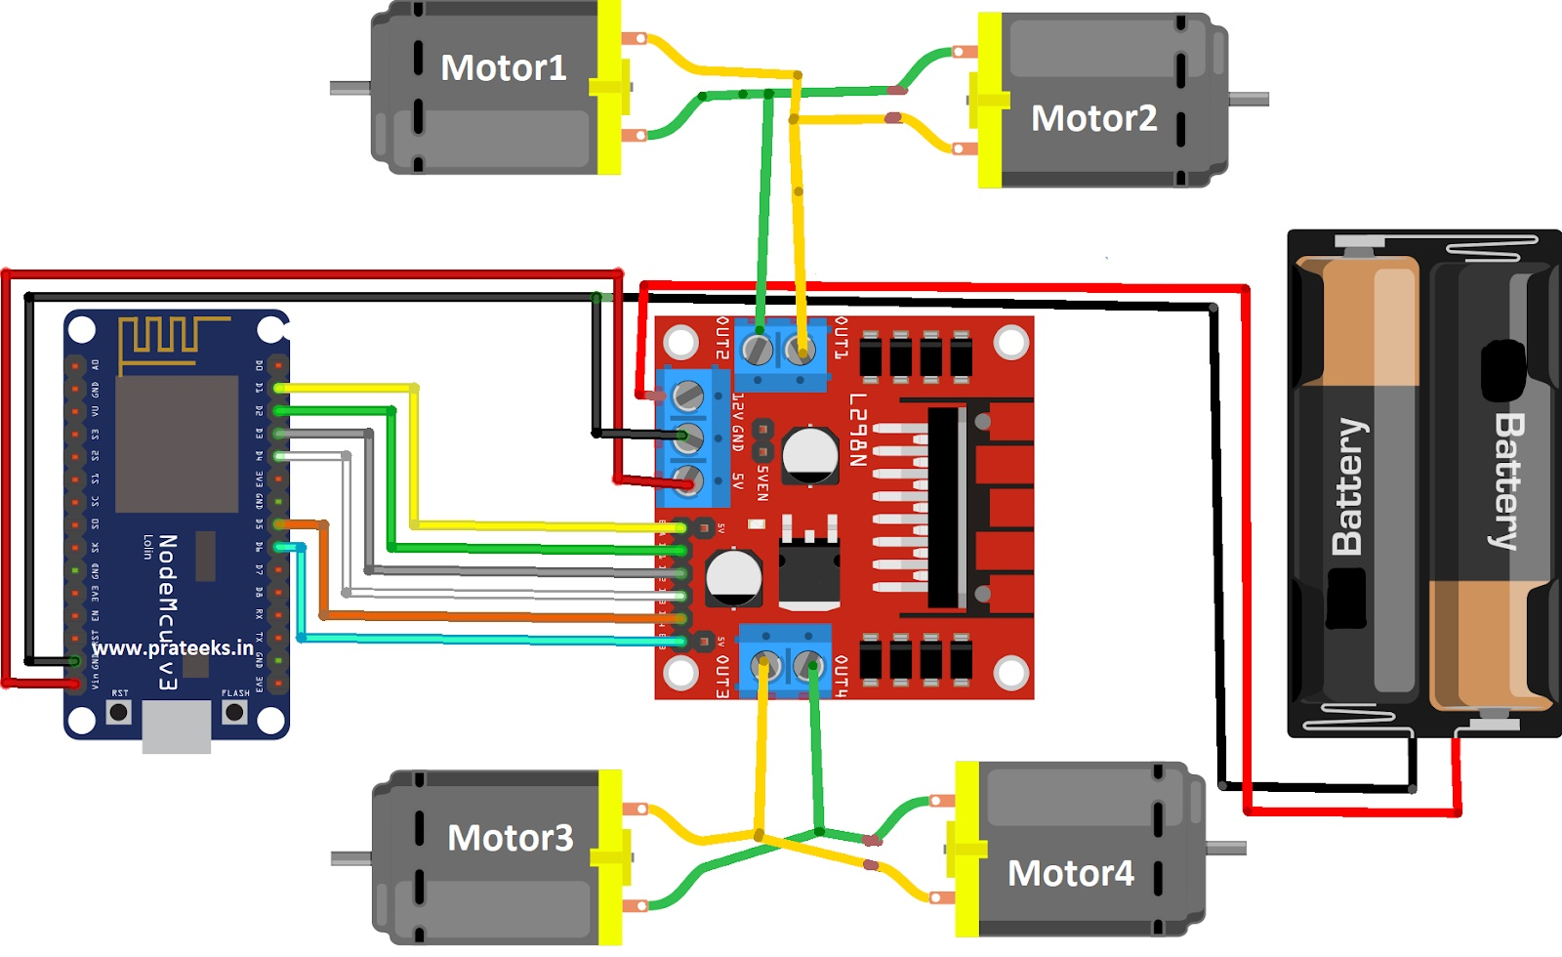
Block Diagram
Circuit Diagram

Slide 10
Application
Military Purpose - It will be utilized as a military robot using a few modifications on it such as Guns, Radar, GPS ,etc . Where military rangers can not go, it may be utilized as a surveillance bot. Even Russian Army has produced some prototypes of these robots will be contained in the military sooner
Smart Mechanism - With it’s mechanism it maximum efficancy for transferring as it’s motivated from nature ( MOVES LIKE Spider), it consumes less electricity. It’s also very much shock and light absorbing if it’s composed of lighter and proper stuff like carbon fiber etc.
Rough Terrain Use - Since it’s an all terrain vehicle it may be utilized for Planetry Exploration such as Mars since it’s highest payload to weight ratio compared to some other robots.

Slide 11
Conclusion:
A new type of walking robot based upon Theo Jansen mechanism is presented. From the Kinematical analysis results it appears that the acceleration of the end point of the foot has a low value. This is important to obtain a smooth motion and a reduced impact at the contact with the ground during walking and it represents an advantage in using this type of mechanism for building a walking robot. This is the study about the Theo-Jansen four leg walking robot. The objective was to built up new mechanical robotic walker using eight bar link mechanism. In future we will use this robot to perform different type of operations automatically by using sensors.
With the rising manmade and natural disaster threats, it is highly probable that there will be an increase in disaster management and surveillance robots incorporating Jansen’s mechanism. Also, there is high potential for development of other applications like bomb disposal, security surveillance, spy operations, exploration, pitch marking, stair climbing, moving furniture, etc based on this mechanism in future.

